Slide 1
Chapter 6: Synchronization Tools

Slide 2
Outline
Background
The Critical-Section Problem
Peterson’s Solution
Hardware Support for Synchronization
Mutex Locks
Semaphores
Monitors
Liveness
Evaluation

Slide 3
Background
Processes can execute concurrently
May be interrupted at any time, partially completing execution
Concurrent access to shared data may result in data inconsistency
Maintaining data consistency requires mechanisms to ensure the orderly execution of cooperating processes
We illustrated in chapter 4 the problem when we considered the Bounded Buffer problem with use of a counter that is updated concurrently by the producer and consumer, which lead to race condition.

Slide 4
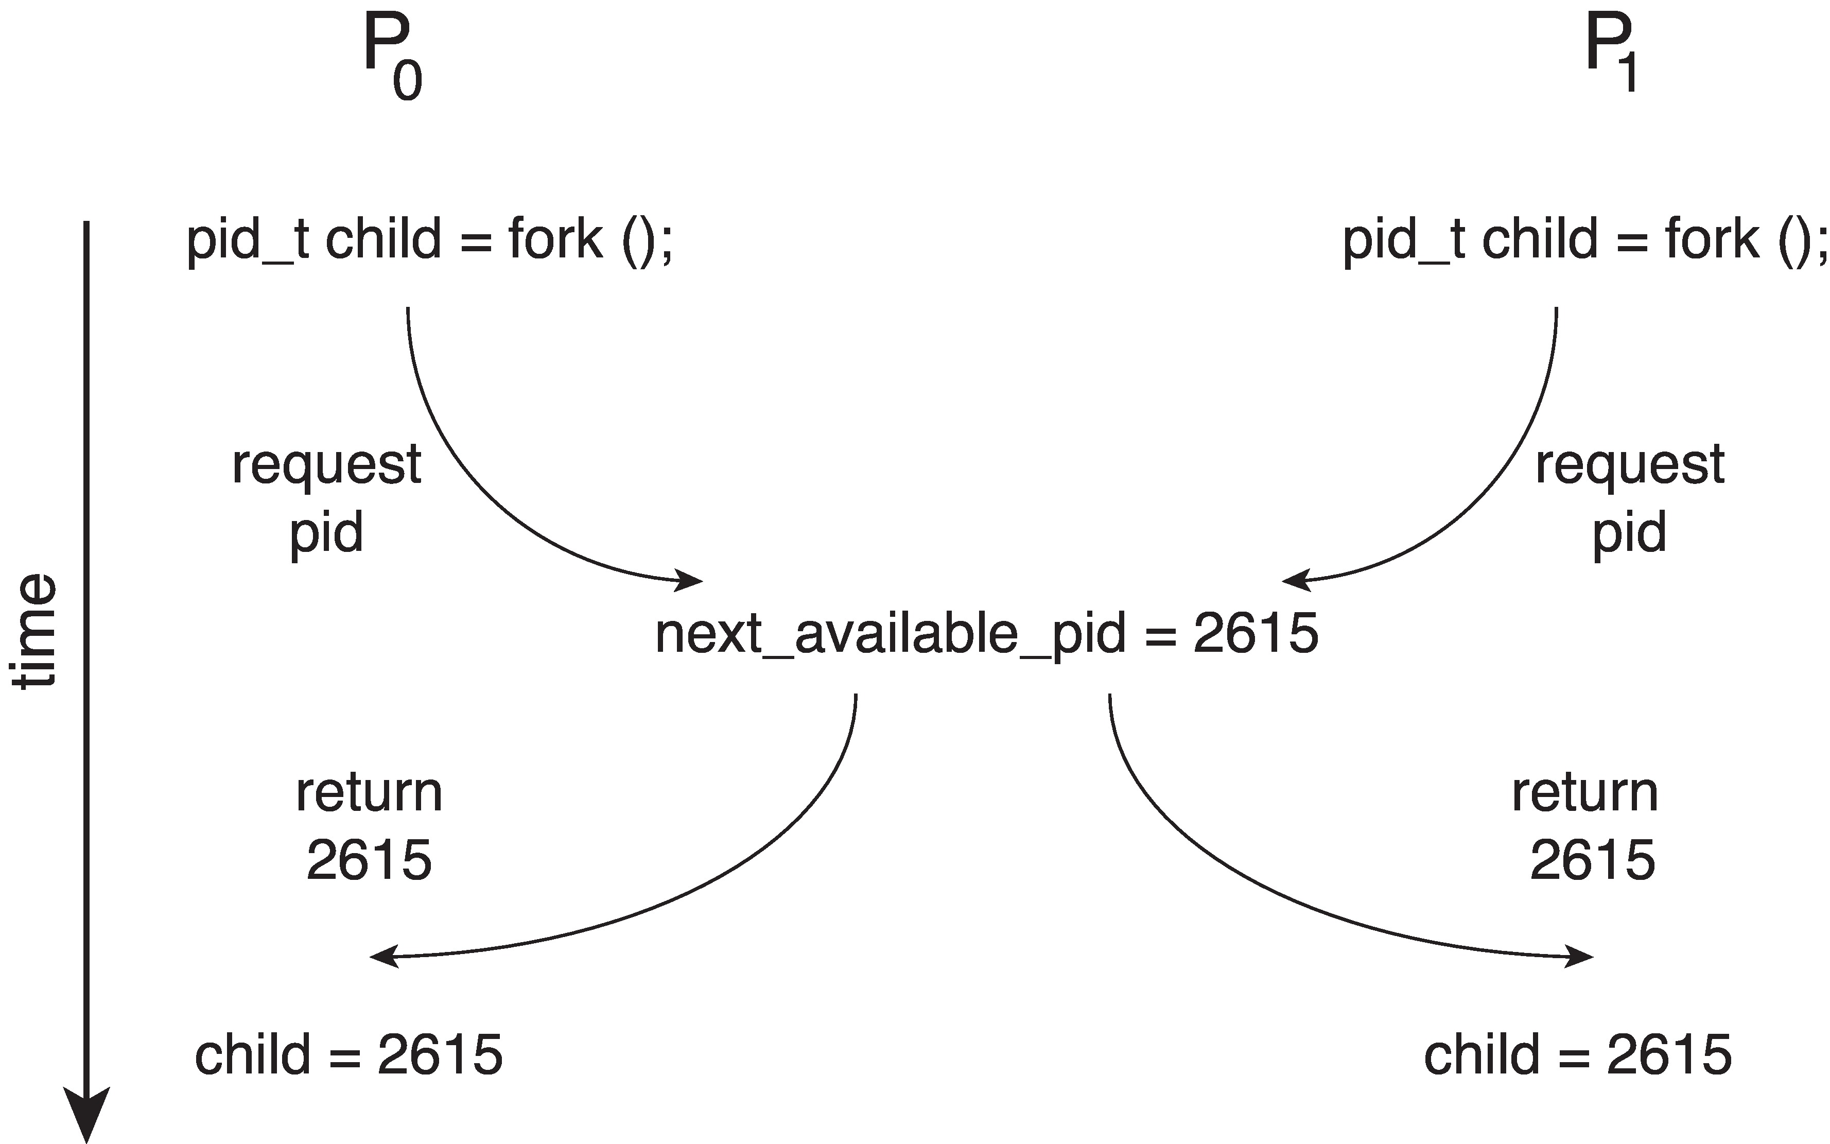
Race Condition
Processes P₀ and P₁ are creating child processes using the fork() system call
Race condition on kernel variable next_available_pid which represents the next available process identifier (pid)
Unless there is a mechanism to prevent P₀ and P₁ from accessing the variable next_available_pid the same pid could be assigned to two different processes!

Slide 5
Critical Section Problem
Consider system of n processes {p₀, p₁, … p_{n-1}}
Each process has critical section segment of code
Process may be changing common variables, updating table, writing file, etc.
When one process in critical section, no other may be in its critical section
Critical section problem is to design protocol to solve this
Each process must ask permission to enter critical section in entry section, may follow critical section with exit section, then remainder section

Slide 6
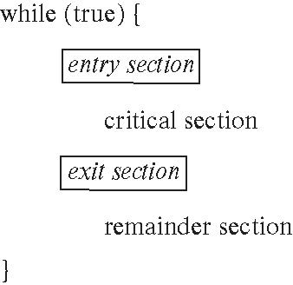
Critical Section
General structure of process P_{i}

Slide 7
Critical-Section Problem (Cont.)
Requirements for solution to critical-section problem
Mutual Exclusion - If process P_{i} is executing in its critical section, then no other processes can be executing in their critical sections
Progress - If no process is executing in its critical section and there exist some processes that wish to enter their critical section, then the selection of the process that will enter the critical section next cannot be postponed indefinitely
Bounded Waiting - A bound must exist on the number of times that other processes are allowed to enter their critical sections after a process has made a request to enter its critical section and before that request is granted
Assume that each process executes at a nonzero speed
No assumption concerning relative speed of the n processes

Slide 8
Interrupt-based Solution
Entry section: disable interrupts
Exit section: enable interrupts
Will this solve the problem?
What if the critical section is code that runs for an hour?
Can some processes starve – never enter their critical section.
What if there are two CPUs?

Slide 9
Software Solution 1
Two process solution
Assume that the load and store machine-language instructions are atomic; that is, cannot be interrupted
The two processes share one variable:
int turn;
The variable turn indicates whose turn it is to enter the critical section
initially, the value of turn is set to i

Slide 10
Algorithm for Process P_{i}
while (true){
while (turn = = j);
/* critical section */
turn = j;
/* remainder section */
}

Slide 11
Correctness of the Software Solution
Mutual exclusion is preserved
P_{i} enters critical section only if:
turn = i
and turn cannot be both 0 and 1 at the same time

Slide 12
Peterson’s Solution
Two process solution
Assume that the load and store machine-language instructions are atomic; that is, cannot be interrupted
The two processes share two variables:
int turn;
boolean flag[2]
The variable turn indicates whose turn it is to enter the critical section
The flag array is used to indicate if a process is ready to enter the critical section.
flag[i] = true implies that process P_{i} is ready!

Slide 13
Algorithm for Process P_{i}
while (true){
flag[i] = true;
turn = j;
while (flag[j] && turn = = j)
;
/* critical section */
flag[i] = false;
/* remainder section */
}

Slide 14
Correctness of Peterson’s Solution
Provable that the three CS requirement are met:
1. Mutual exclusion is preserved
P_{i} enters CS only if:
either flag[j] = false or turn = i
2. Progress requirement is satisfied
3. Bounded-waiting requirement is met

Slide 15
Peterson’s Solution and Modern Architecture
Although useful for demonstrating an algorithm, Peterson’s Solution is not guaranteed to work on modern architectures.
To improve performance, processors and/or compilers may reorder operations that have no dependencies
Understanding why it will not work is useful for better understanding race conditions.
For single-threaded this is ok as the result will always be the same.
For multithreaded the reordering may produce inconsistent or unexpected results!

Slide 16
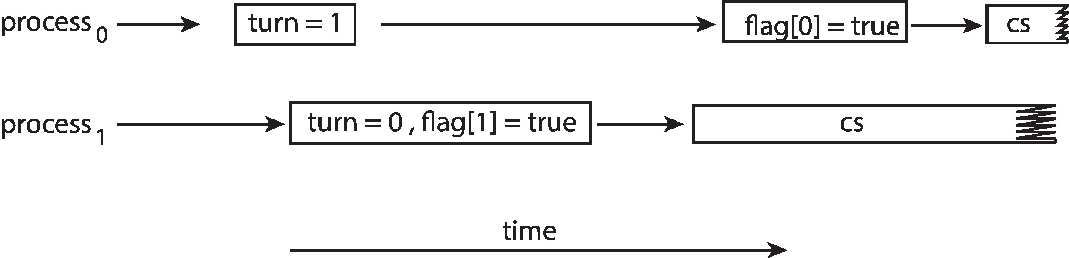
Peterson’s Solution Revisited
The effects of instruction reordering in Peterson’s Solution
This allows both processes to be in their critical section at the same time!
To ensure that Peterson’s solution will work correctly on modern computer architecture we must use Memory Barrier.

Slide 17
Memory Barrier
Memory model are the memory guarantees a computer architecture makes to application programs.
Memory models may be either:
Strongly ordered – where a memory modification of one processor is immediately visible to all other processors.
Weakly ordered – where a memory modification of one processor may not be immediately visible to all other processors.
A memory barrier is an instruction that forces any change in memory to be propagated (made visible) to all other processors.

Slide 18
Memory Barrier Instructions
When a memory barrier instruction is performed, the system ensures that all loads and stores are completed before any subsequent load or store operations are performed.
Therefore, even if instructions were reordered, the memory barrier ensures that the store operations are completed in memory and visible to other processors before future load or store operations are performed.

Slide 19
Synchronization Hardware
Many systems provide hardware support for implementing the critical section code.
Uniprocessors – could disable interrupts
Currently running code would execute without preemption
Generally too inefficient on multiprocessor systems
Operating systems using this not broadly scalable
We will look at two forms of hardware support: 1. Hardware instructions 2. Atomic variables

Slide 20
Hardware Instructions
Special hardware instructions that allow us to either test-and-modify the content of a word, or to swap the contents of two words atomically (uninterruptedly.)
Test-and-Set instruction
Compare-and-Swap instruction

Slide 21
The test_and_set Instruction
Definition
boolean test_and_set (boolean *target)
{
boolean rv = *target;
*target = true;
return rv:
}
Properties
Executed atomically
Returns the original value of passed parameter
Set the new value of passed parameter to true

Slide 22
The compare_and_swap Instruction
Definition
int compare_and_swap(int *value, int expected, int new_value)
{
int temp = *value;
if (*value == expected)
*value = new_value;
return temp;
}
Properties
Executed atomically
Returns the original value of passed parameter value
Set the variable value the value of the passed parameter new_value but only if *value == expected is true. That is, the swap takes place only under this condition.

Slide 23
Atomic Variables
Typically, instructions such as compare-and-swap are used as building blocks for other synchronization tools.
One tool is an atomic variable that provides atomic (uninterruptible) updates on basic data types such as integers and booleans.
For example:
Let sequence be an atomic variable
Let increment() be operation on the atomic variable sequence
The Command:
increment(&sequence);
ensures sequence is incremented without interruption:

Slide 24
Atomic Variables
The increment() function can be implemented as follows: void increment(atomic_int *v) { int temp; do { temp = *v; } while (temp != (compare_and_swap(v,temp,temp+1)); }

Slide 25
Mutex Locks
Previous solutions are complicated and generally inaccessible to application programmers
OS designers build software tools to solve critical section problem
Simplest is mutex lock
Boolean variable indicating if lock is available or not
Protect a critical section by
First acquire() a lock
Then release() the lock
Calls to acquire() and release() must be atomic
Usually implemented via hardware atomic instructions such as compare-and-swap.
But this solution requires busy waiting
This lock therefore called a spinlock

Slide 26
Solution to CS Problem Using Mutex Locks
while (true) {
acquire lock
critical section
release lock
remainder section
}

Slide 27
Semaphore
Synchronization tool that provides more sophisticated ways (than Mutex locks) for processes to synchronize their activities.
Semaphore S – integer variable
Can only be accessed via two indivisible (atomic) operations
wait() and signal()
Originally called P() and V()
Definition of the wait() operation
wait(S) {
while (S <= 0)
; // busy wait
S--;
}
Definition of the signal() operation
signal(S) {
S++;
}

Slide 28
Semaphore (Cont.)
Counting semaphore – integer value can range over an unrestricted domain
Binary semaphore – integer value can range only between 0 and 1
Same as a mutex lock
Can implement a counting semaphore S as a binary semaphore
With semaphores we can solve various synchronization problems

Slide 29
Semaphore Implementation
Must guarantee that no two processes can execute the wait() and signal() on the same semaphore at the same time
Thus, the implementation becomes the critical section problem where the wait and signal code are placed in the critical section
Could now have busy waiting in critical section implementation
But implementation code is short
Little busy waiting if critical section rarely occupied
Note that applications may spend lots of time in critical sections and therefore this is not a good solution

Slide 30
Semaphore Implementation with no Busy waiting
With each semaphore there is an associated waiting queue
Each entry in a waiting queue has two data items:
Value (of type integer)
Pointer to next record in the list
Two operations:
block – place the process invoking the operation on the appropriate waiting queue
wakeup – remove one of processes in the waiting queue and place it in the ready queue

Slide 31
Monitors
A high-level abstraction that provides a convenient and effective mechanism for process synchronization
Abstract data type, internal variables only accessible by code within the procedure
Only one process may be active within the monitor at a time
Pseudocode syntax of a monitor:
monitor monitor-name
{
// shared variable declarations
procedure P1 (…) { …. }
procedure P2 (…) { …. }
procedure Pn (…) {……}
initialization code (…) { … }
}

Slide 32
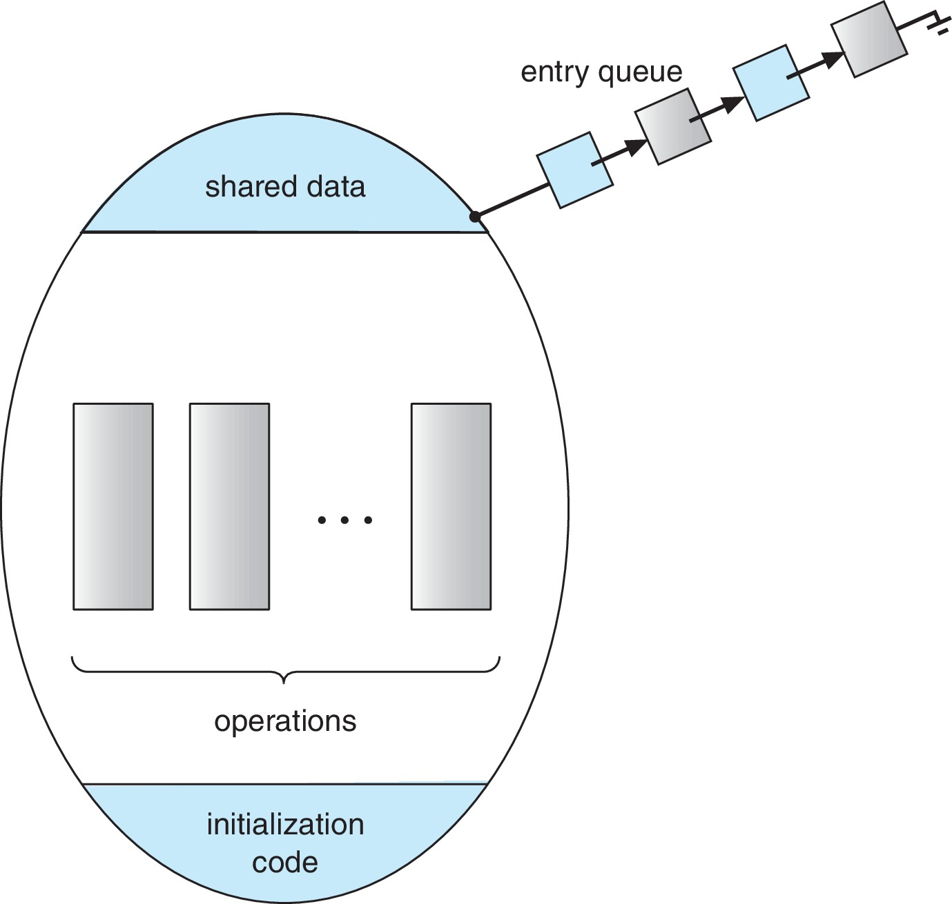
Schematic view of a Monitor

Slide 33
Monitor Implementation Using Semaphores
Variables
semaphore mutex
mutex = 1
Each procedure P is replaced by
wait(mutex);
…
body of P;
…
signal(mutex);
Mutual exclusion within a monitor is ensured

Slide 34
Condition Variables
condition x, y;
Two operations are allowed on a condition variable:
x.wait() – a process that invokes the operation is suspended until x.signal()
x.signal() – resumes one of processes (if any) that invoked x.wait()
If no x.wait() on the variable, then it has no effect on the variable

Slide 35
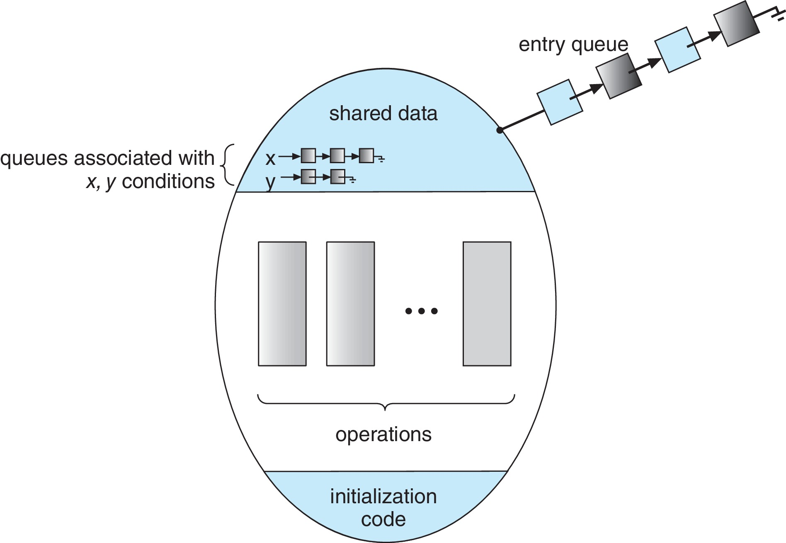
Monitor with Condition Variables

Slide 36
Resuming Processes within a Monitor
If several processes queued on condition variable x, and x.signal() is executed, which process should be resumed?
FCFS frequently not adequate
Use the conditional-wait construct of the form
x.wait(c)
where:
c is an integer (called the priority number)
The process with lowest number (highest priority) is scheduled next

Slide 37
Liveness
Processes may have to wait indefinitely while trying to acquire a synchronization tool such as a mutex lock or semaphore.
Waiting indefinitely violates the progress and bounded-waiting criteria discussed at the beginning of this chapter.
Liveness refers to a set of properties that a system must satisfy to ensure processes make progress.
Indefinite waiting is an example of a liveness failure.

Slide 38
Liveness
Deadlock – two or more processes are waiting indefinitely for an event that can be caused by only one of the waiting processes
Let S and Q be two semaphores initialized to 1
P₀ P₁
wait(S); wait(Q);
wait(Q); wait(S);
... ...
signal(S); signal(Q);
signal(Q); signal(S);
Consider if P₀ executes wait(S) and P₁ wait(Q). When P₀ executes wait(Q), it must wait until P₁ executes signal(Q)
However, P₁ is waiting until P₀ execute signal(S).
Since these signal() operations will never be executed, P₀ and P₁ are deadlocked.

Slide 39
Liveness
Other forms of deadlock:
Starvation – indefinite blocking
A process may never be removed from the semaphore queue in which it is suspended
Priority Inversion – Scheduling problem when lower-priority process holds a lock needed by higher-priority process
Solved via priority-inheritance protocol

Slide 40
End of Chapter 6

